Slide 1
2023/2024 Sponsorships
BETHESDA CHAPTER
NCMA bethesda Chapter Sponsorship Campaign
Contracting Professionalism

Slide 2
Our Mission, Vision, and Values
Our Mission
NCMA’s mission is to advance the contract management profession through advocacy and the execution of programs to connect NCMA members and enable their professional development.
Our Vision for the Profession
Contract management will be viewed by all organizations and leaders — public and private — as an essential business management function that directly contributes to organizational success.
Professionals will recognize contract management as a challenging, rewarding and essential career, and will prepare for and seek out positions in the profession.
Universities will recognize the critical role of contract management and provide undergraduate and graduate degree programs and courses designed to prepare students for entry into or advancement in the contract management profession
Industry, government, and academia recognizes a set of standards that are required for performance and advancement in the contract management career field.
Our Vision for the Organization
NCMA will lead in defining the standards and the body of knowledge for the contract management profession.
NCMA will provide advocacy, training, education, and certifications that enable the entry, development, and advancement of all contract management professionals.
NCMA will be a model for not-for-profit individual membership organizations; recognized for innovation, effective, and efficient operations; and agile responsible governance and active engagement in the contract management profession.
NCMA will be a recognized as the premier organization for connecting, educating, and certifying contract management professionals.
Our Value Propositions
NCMA’s strength lies in our loyal and diverse base of membership representing the full spectrum of contract management professionals across government, industry, academia, and the nonprofit sector.

Slide 3
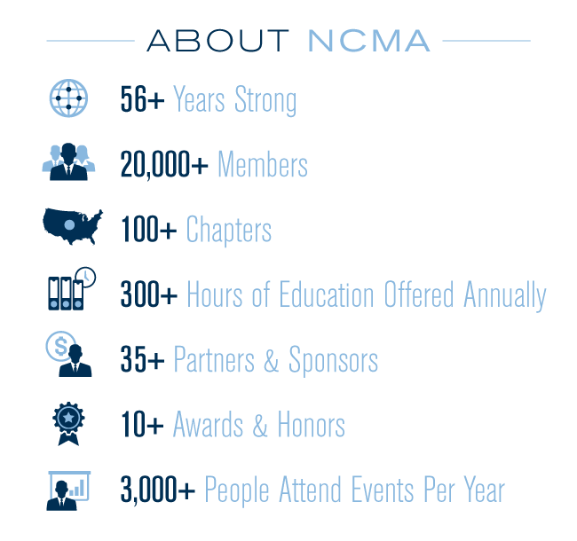
WHO WE ARE
The National Contract Management Association (NCMA), founded in 1959, is the world’s leading professional resource for those in the field of contract management. The organization, which has over 20,000 members, is dedicated to the professional growth and educational advancement of procurement and acquisition personnel worldwide. NCMA strives to serve and inform the profession it represents and to offer opportunities for the open exchange of ideas in neutral forums.

Slide 4
Sponsorship
As NCMA ambitions grow to support for our local procurement community through scholarships, training workshops, and guidance; the necessity for the local community to get involved has never been greater.
Seize your opportunity to make a difference in a big way! This all-new Sponsorship Program has been developed to accomplish several objectives.
Raise funds to fuel the passion and growth of our chapter through things like the Scholarship Program, Training Program, and our overall objective to better support our community and members.
Create excitement within our local community to get more people involved and increase our memberships.
Provide incentive for new federal and private agencies to learn more about NCMA, its history, its mission statement, and how their participation can be beneficial to all.
The Sponsorship Program will be structured into (4) levels for a program year.
Platinum--$2,500.00 for a single event or $6,000.00 for the entire program year.
Gold--$1,500.00 for a single event or $4,000.00 for the entire program year.
Silver--$500.00 for a single event or $2,000.00 for the entire program year.
In-kind—Breakfast or Networking events.
ACT NOW! Don’t miss your chance to be a vital part of strengthening our community and its contracting professionals.

Slide 5
NCMA Bethesda Chapter Sponsorship Levels
Platinum Sponsorship Level--$2,500.00 for single event or $6,000,00 for the entire program year
Speaker Introduction at dinner meeting of choice.
Sponsor displays a Company Banner at dinner meetings.
Sponsor will receive four (4) complimentary dinner tickets for each meeting with additional guests at the member rate. Note: This applies only to entire program year sponsorships and excludes the all-day NES Seminars.
Display of company logo and website on NCMA Bethesda webpage.
Opportunity to leave literature at dinner events.
Gold Sponsorship Level --$1,500.00 for a single event or $4,000.00 for the entire program year
Sponsors displays a Company Banner at dinner meetings.
Sponsor will receive three (3) complimentary dinner tickets for each meeting with additional guests at the member rate. Note: This applies only to entire program year sponsorships and excludes the all-day NES Seminars.
Display of company logo and website on NCMA Bethesda webpage.
Opportunity to leave literature at dinner events
Silver Sponsorship Level --$500.00 for a single event or $2,000.00 for the entire program year
Display of company logo and website on NCMA Bethesda webpage.
Sponsor will receive two (2) complimentary dinner tickets for each meeting with additional guests at the member rate. Note: This applies only to entire program year sponsorships and excludes the all-day NES Seminars.
In-kind Sponsorship---Breakfast or Networking Events
Venue Partner: Donate the host venue for the event; Beverage/Catering Partner: Provide food and drinks for the event; Gift Partner: Exclusive company to provide branded premium for the event.
In Kind-Sponsors receive– Social Media Shout Outs.

Slide 6
JOIN OUR CURRENT SPONSORS
If you have any questions or want to know how to become a Bethesda NCMA Chapter Sponsor please contact us at ncmabethesda@gmail.com or 240.784.7418.

